Slide 1
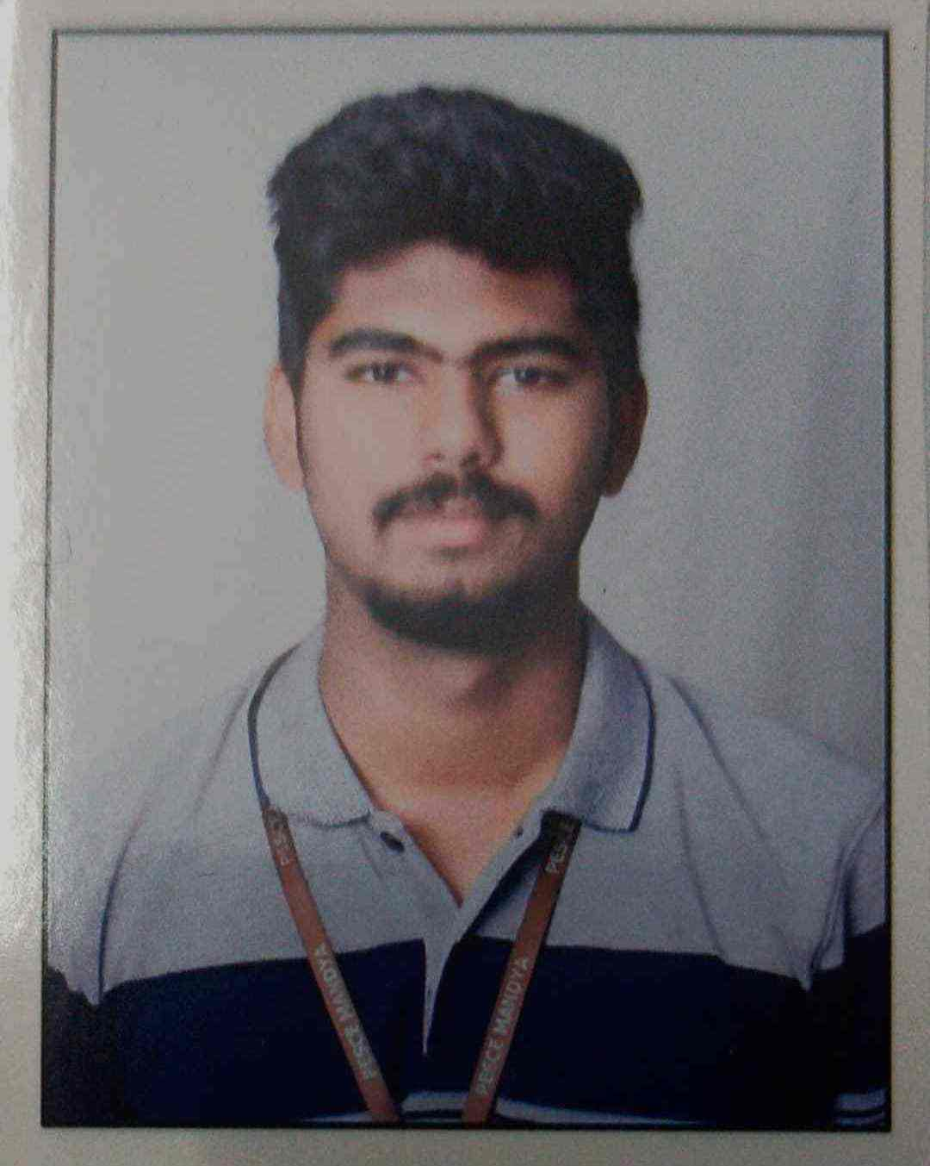

Rajath B Giri
Analyst/Software Engineer
Electronics and communication engineering
2018- 2022
Skills
Java OOPS, Collection, Generics, Exception Handling, Annotation Java 8- Lambda Function, Stream, Functional Interface JDBC
Backend
Spring Boot/Spring Security REST-API JPA CRUD
Database
MongoDB
Web Technologies
HTML5, CSS
JavaScript Angular
Tools/IDE
Eclipse
Visual Studio Code
Postman
Swagger API
AddOn Skills
Good Communication
skills
Team player
Adaptability
Mumbai
rajath-b.giri@capgemini.com
+91 9036039427
A4
Full Stack Developer
Open to learn new technologies and ready to implement them to further improve my knowledge
Hands on experience in creating microservices with Springboot, Spring Security, Spring Cloud API Gateway, Eureka server.
Proficient in creating Single page Web Application in Angular .
Angular developer with working knowledge on components, forms, routing and Material UI.
Development experience using Eclipse, VS Code, postman Api connection and MongoDB.
Flight Booking System
Completed end to end case study of Flight booking System with microservice architecture, JWT authentication, Swagger and payment testing using razor pay, database using MongoDB, Angular used for user interface.

